Slide 1
Autocorrect+ AI-Enhanced Descriptive Answer Evaluation
Gayathri Devi Atluri- gatluri@kent.edu – 811256395
Harika Malneedi- hmalneed@kent.edu-811255562
Sai Haritha Udatha- sudatha@kent.edu- 811238202
Bhanu siva kumar komanna- bkomman1@kent.edu- 811252220
Mani Surya Teja Kota- mkota1@kent.edu- 811262686
Veeraraghava raju Lolabhattu- klolabha@kent.edu- 811301662

Slide 2
Abstract
AutoCorrect+ is an innovative solution designed to automate the correction of descriptive answer sheets. This solution attempts to simplify the grading process for educators while guaranteeing accuracy, consistency, and time efficiency by utilizing cutting-edge natural language processing (NLP) and machine learning techniques.
There have been several attempts to use computer science to grade students responses. To do this, the majority of the job, however, makes use of conventional counts or certain terms. Additionally, there aren't enough carefully chosen data sets. In order to automatically assess descriptive responses, we suggest a novel method that makes use of a variety of machine learning, natural language processing, and toolkits, including Wordnet, Word2vec, word mover's distance (WMD), cosine similarity, multinomial naive bayes (MNB), and term frequency-inverse document frequency (TF-IDF). Answers are assessed using solution statements and keywords, and the grades are predicted by training a machine learning model.

Slide 3
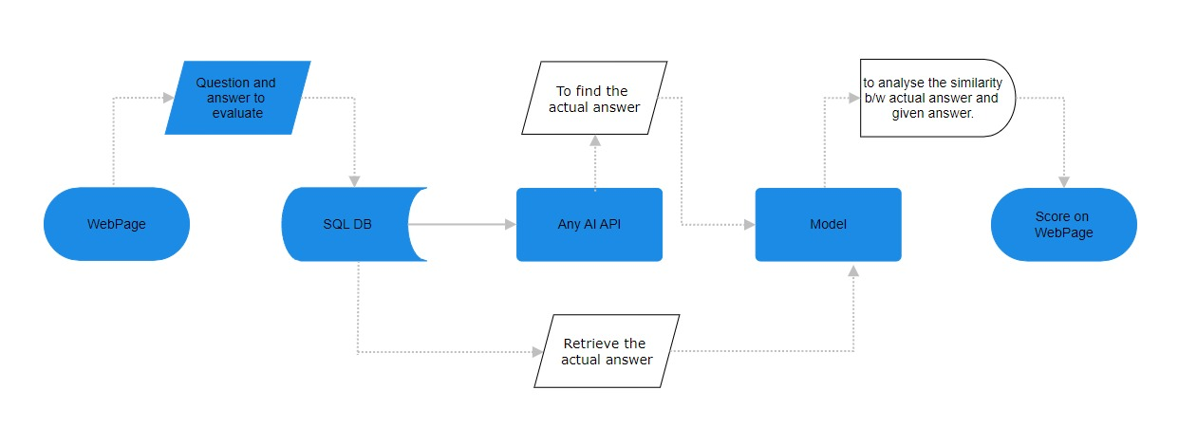
Workflow

Slide 4

Technologies
Programming languages:
Python, Javascript, AngularJS
Methodologies:
NLP, Cosine Similarity, Word Movers Distance

Slide 5
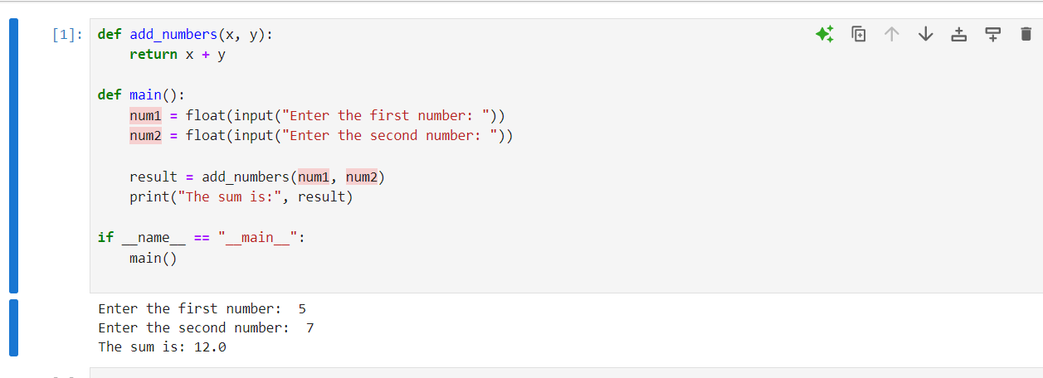
Python Demo

Slide 6
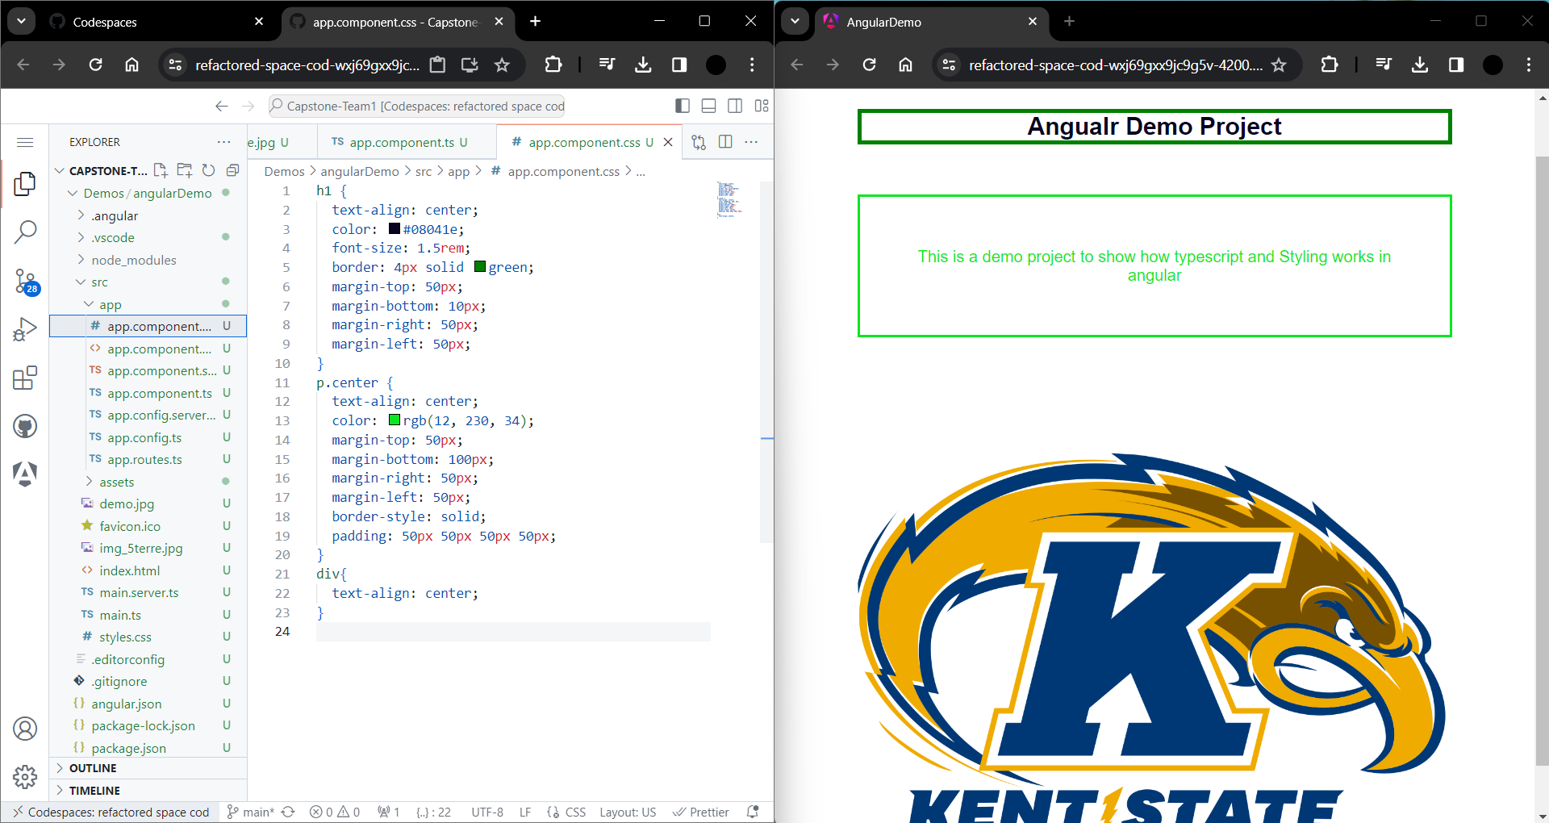
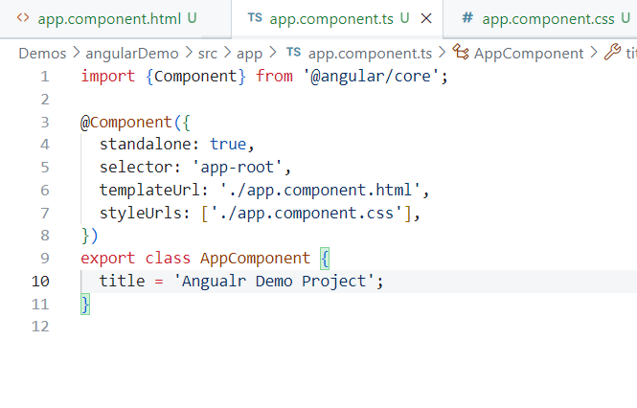
Front-end Demo

Slide 7
Libraries
Nltk:
popular library in Python which provides various tools and resources for tasks like tokenization, stemming, lemmatization, part-of-speech tagging.
Wordnet from nltk.corpus:
It provides access to a vast amount of lexical information, including synonyms, antonyms, hypernyms, hyponyms, and more.
Word_tokenize from nltk.tokenize:
word_tokenize is a function from NLTK used for breaking down sentences into words.
TfidfVectorizer from sklearn.feature_extraction.text
It's used for converting a collection of text documents into a matrix of TF-IDF features.TF-IDF (Term Frequency-Inverse Document Frequency) is a statistical measure used to evaluate the importance of a word in a document relative to a collection of documents.

Slide 8
Libraries
cosine_similarity from sklearn.metrics.pairwise
Cosine similarity is a measure of similarity between two non-zero vectors of an inner product space that measures the cosine of the angle between them.
Word2Vec from gensim.models
Word2Vec is used for training Word Embeddings using the Word2Vec algorithm, which represents words in a continuous vector space where similar words have similar vectors
WmdSimilarity from gensim.similarities
WMD is a method for measuring the dissimilarity between two text documents as the minimum amount of distance that words from one document need to travel to match exactly the words from the other document.

